Slide 1
TEC vs Conventional Space and Competitors

Slide 2
Purpose
To understand the comparison between traditional office space and flexible workspace offered by TEC
To understand how TEC differentiates itself from other major players in the industry

Slide 3
TEC
vs
Conventional Space

Slide 4
1
Feasibility and Flexibility

Slide 5
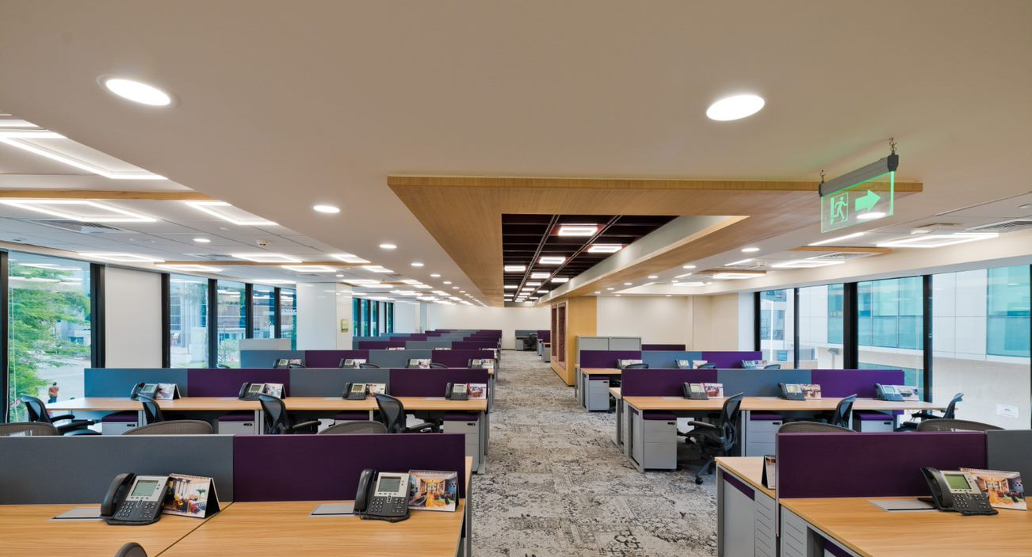
Conventional Space
Difficult to find small office space in premium buildings in Central Business Districts (CBDs)
Landlords may only want large, well-known and established firms as tenants
Bound by long minimum lease term

Slide 6
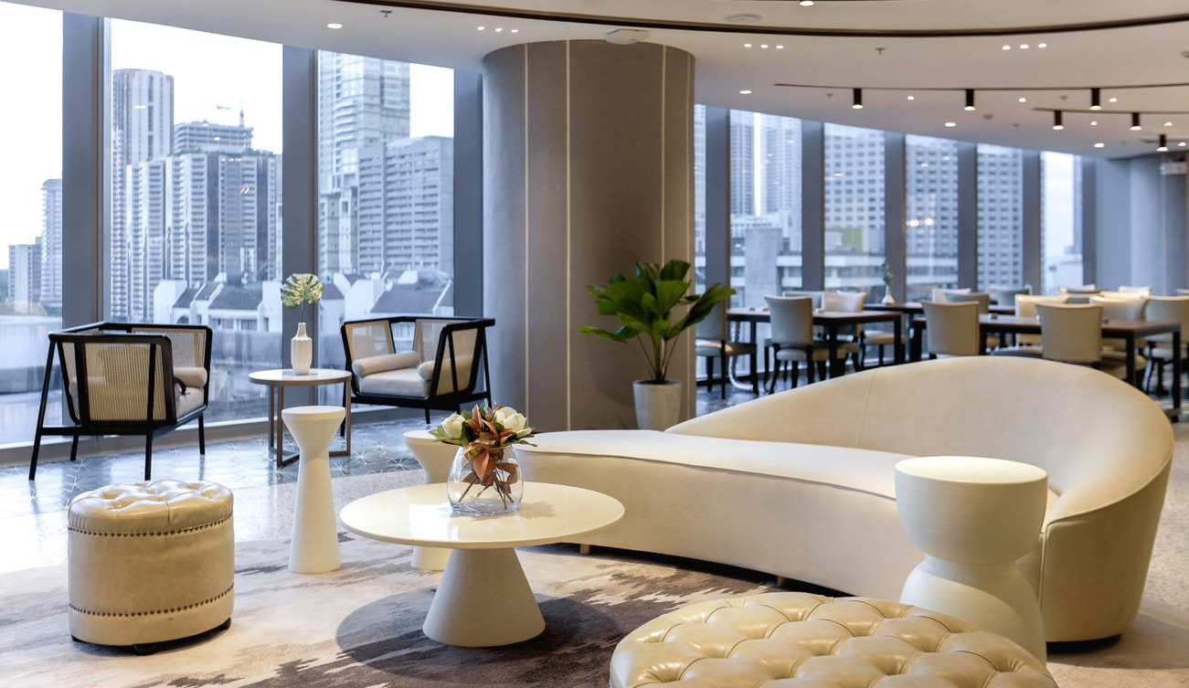
The Executive Centre
TEC allows clients who need anything between 1-100+ workstations
Joining TEC grants the client access to our 150+ locations in grade-A locations across APAC
Lease term can be as little as 1 month

Slide 7
2
Security Deposit and Fit-out

Slide 8
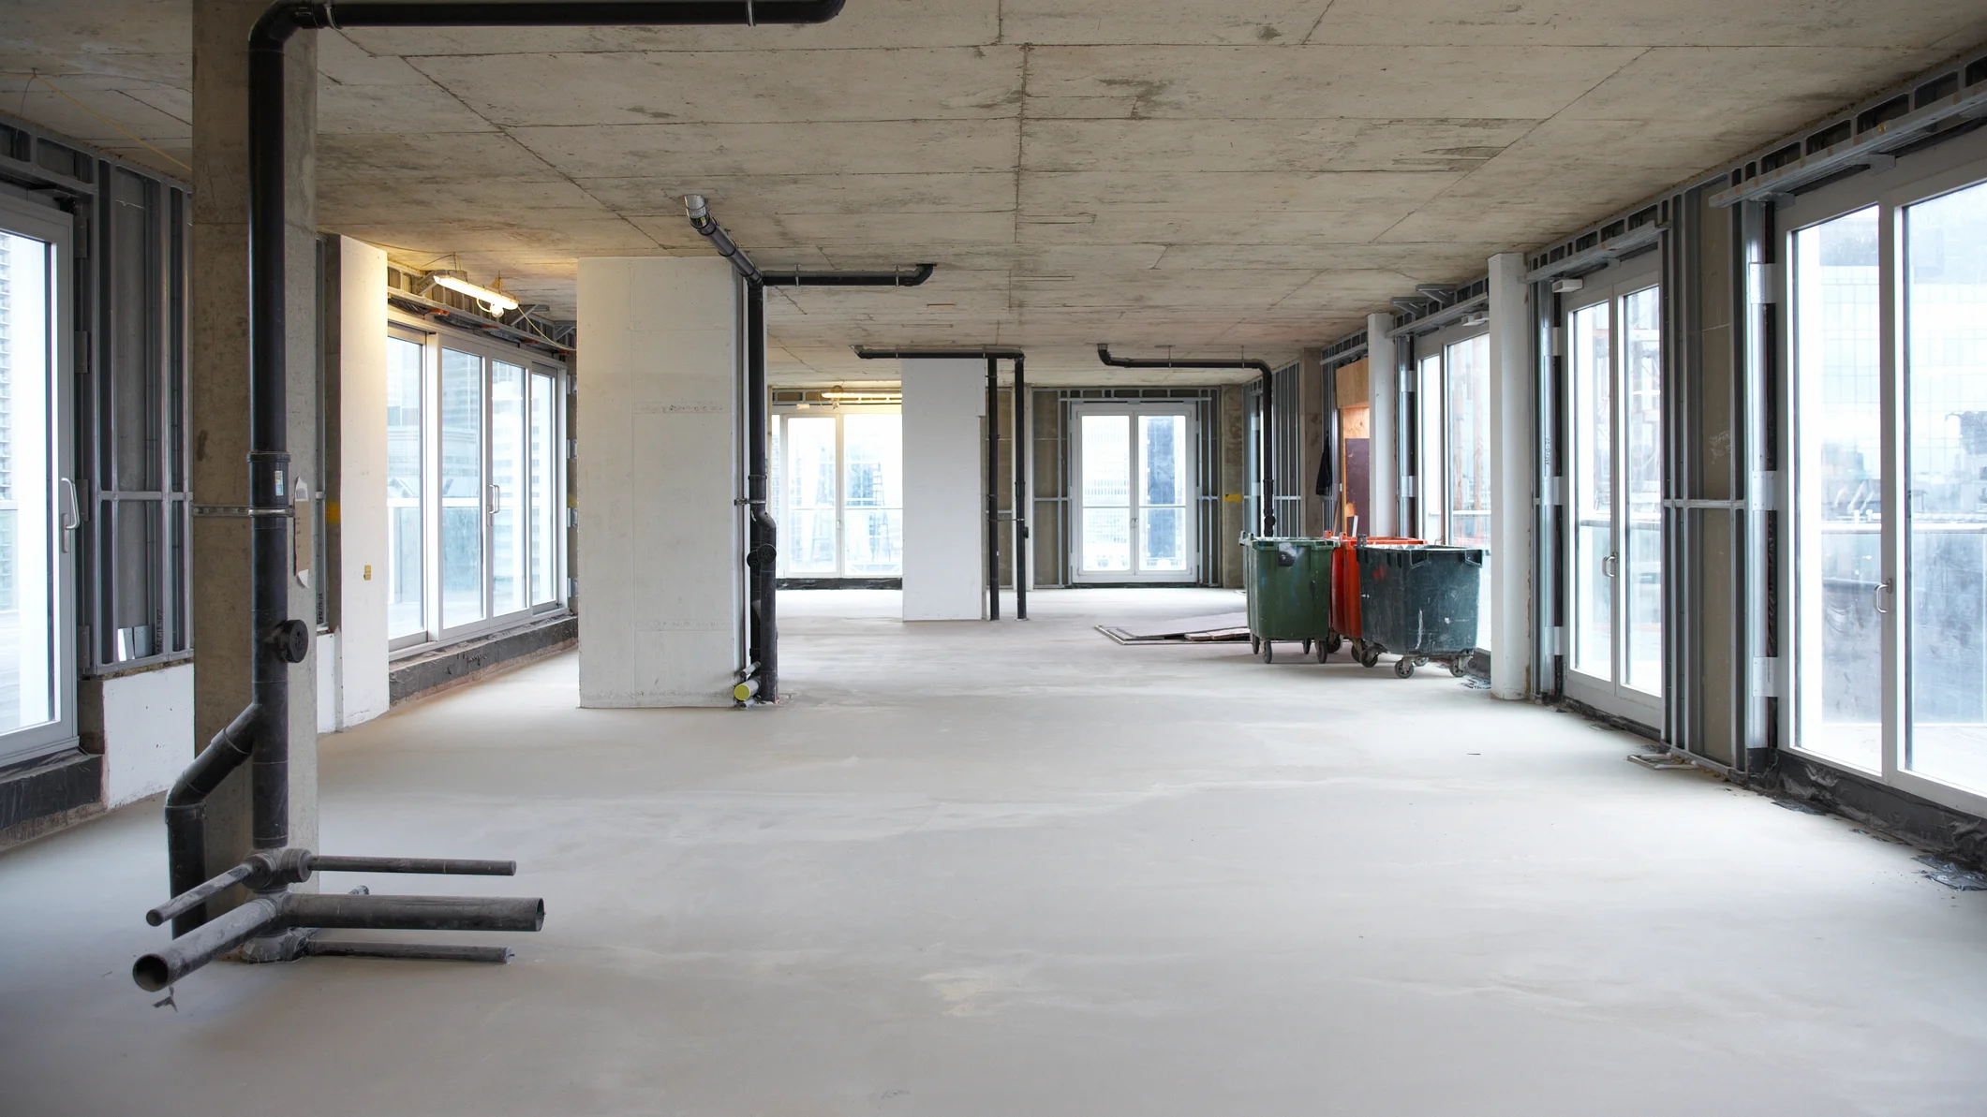
Conventional Space
Landlords may require 3-18 months security deposit
A conventional office space is handed to the tenant as a concrete shell – they must invest lot of money fitting out the office space. Upon termination, they must return the space to its original concrete shell

Slide 9
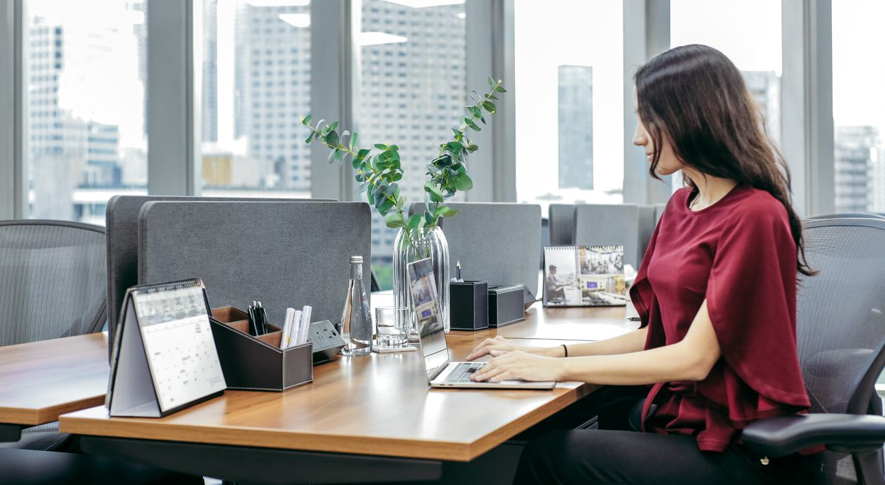
The Executive Centre
TEC only requires 1-3 months security deposit – some of this gets re-invested into the Centre in which the client has their office
The client walks into a fully kitted out premium office space and doesn’t need to spend anything to fit-out the space

Slide 10
True or False
If a business wants to find an office space for 10 people in a building located in the CBD, it is easy for them to find a small office in a conventional office building.
True
False

Slide 11
Multiple Choice Question
What is the minimum term for a licence agreement at TEC?
A: 1 month
B: 3 months
C: 6 months
D: 24 months

Slide 12
True or False
An office space in a conventional office building typically has all fixtures and fittings installed so clients can just walk in and start work straight away.
True
False

Slide 13
3
Licence Fee and Connectivity

Slide 14
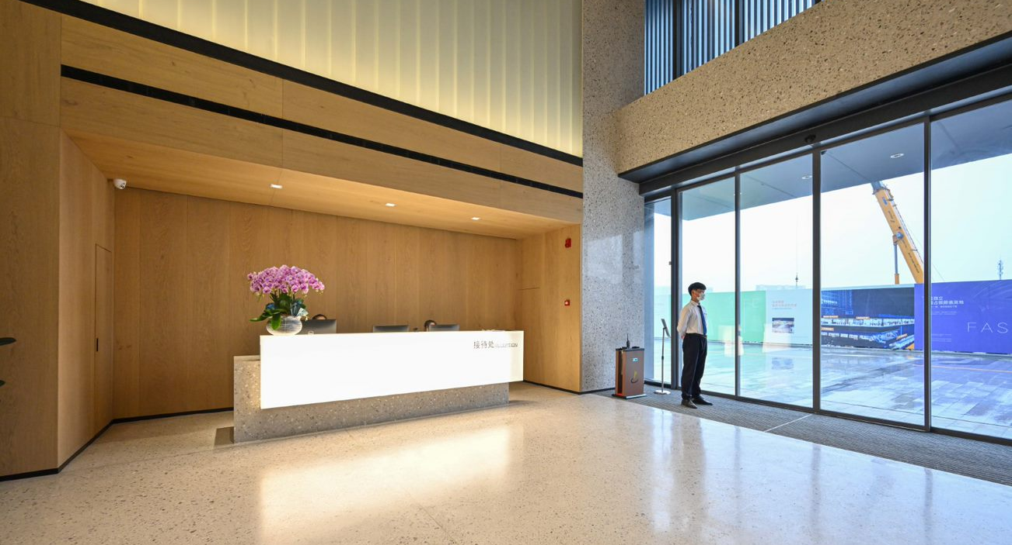
Conventional Space
Usually a minimum space requirement – e.g. 1,000 sq ft.
Need to pay extra fees like management fees, government rates and utilities on top of rent
Must handle set up of internet and phone service with a lack of support

Slide 15

The Executive Centre
The client only pays for the space they need – their private office or workstation
TEC maintains its own IT infrastructure and in-house IT team to support members
No need to worry about air-con, water supply, security in server room, etc.

Slide 16
4
Breakout and Operating costs

Slide 17
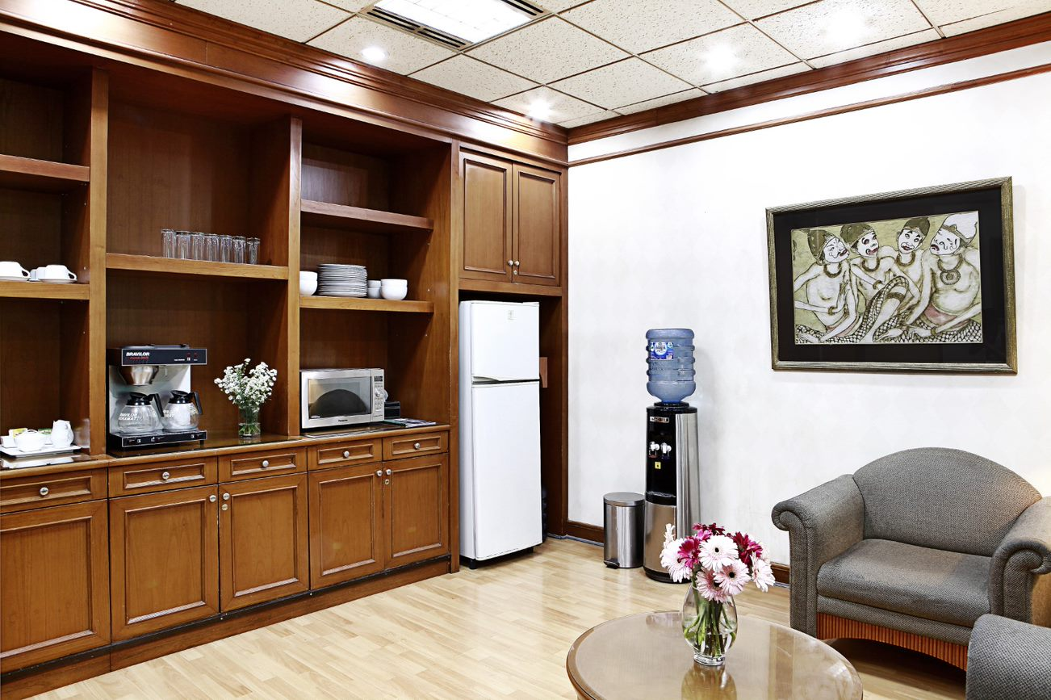
Conventional Space
Clients need to purchase their own pantry equipment and supplies and manage the stock themselves

Slide 18
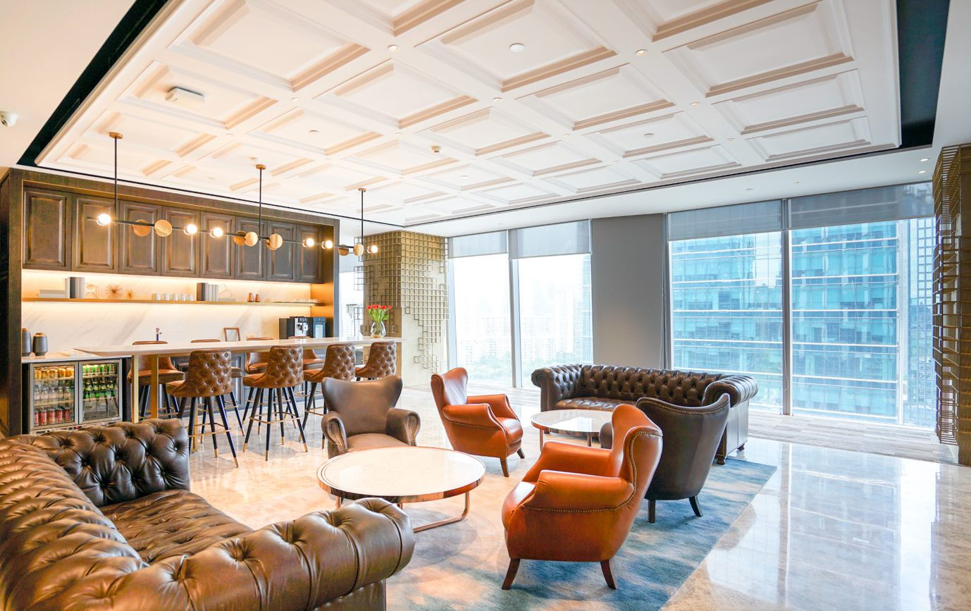
The Executive Centre
Complimentary premium coffee and tea in pantries
Barista services in newer locations
Fully fitted out lounge areas with premium furnishings

Slide 19
5
Teams and Community

Slide 20
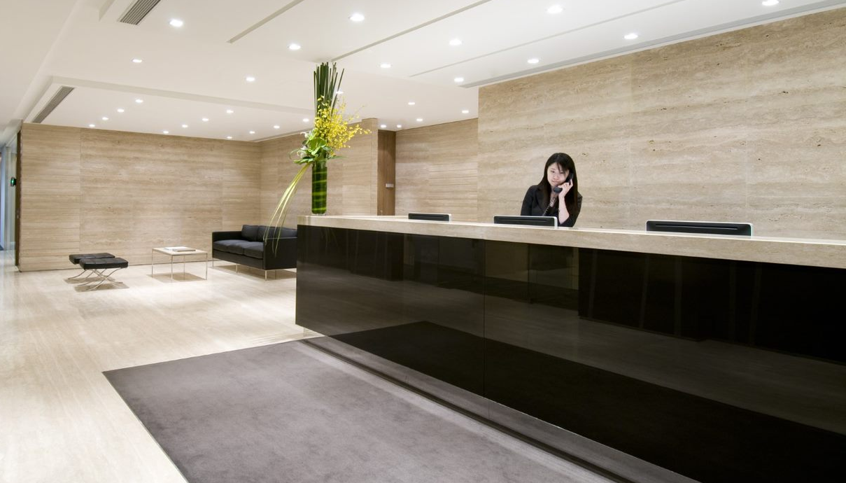
Conventional Space
Office staff have to be hired, trained, insured and all HR related issues must be delt with
No community support and hard to connect with other like-minded businesses

Slide 21
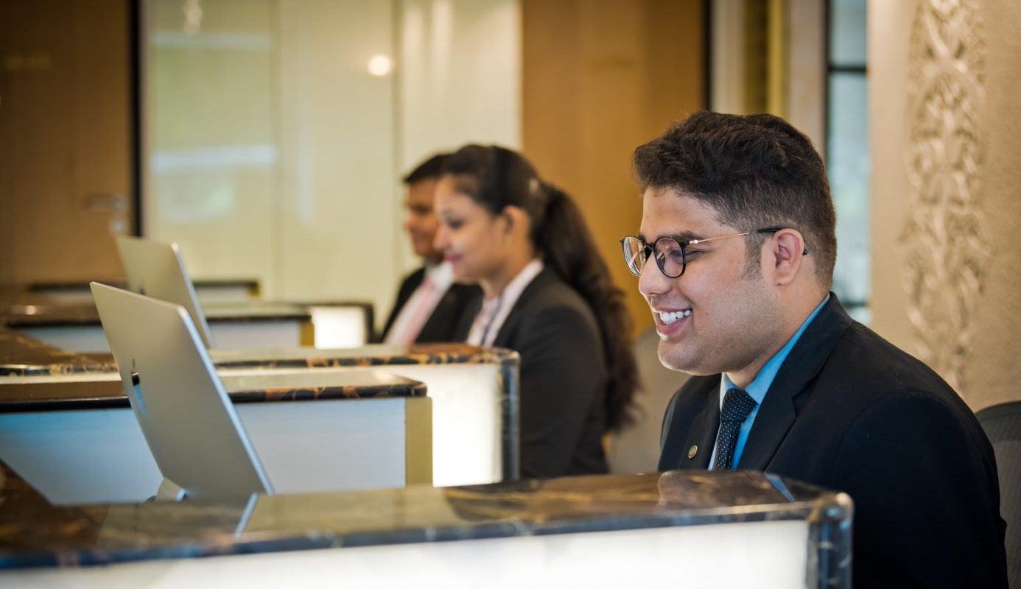
The Executive Centre
A professional and multi-lingual team to support members
Members can leverage on TEC’s thousands of members across APAC and weekly events and networking opportunities organized by the TEC community team

Slide 22
True or False
In Conventional office space, the client must install and maintain their own IT facilities without support
True
False

Slide 23
Multiple-choice question
At the Executive Centre, clients not only get an office space in a premium Grade-A building in the CBD, they also get:
A: Access to a community of like-minded professionals
B: Support from a professional multi-lingual team
C: All fixtures and fittings installed in the office
D: All options are correct

Slide 24
TEC
vs
Competitors

Slide 25
Where is TEC positioned compared to other players in the flexible workspace industry?

Slide 26
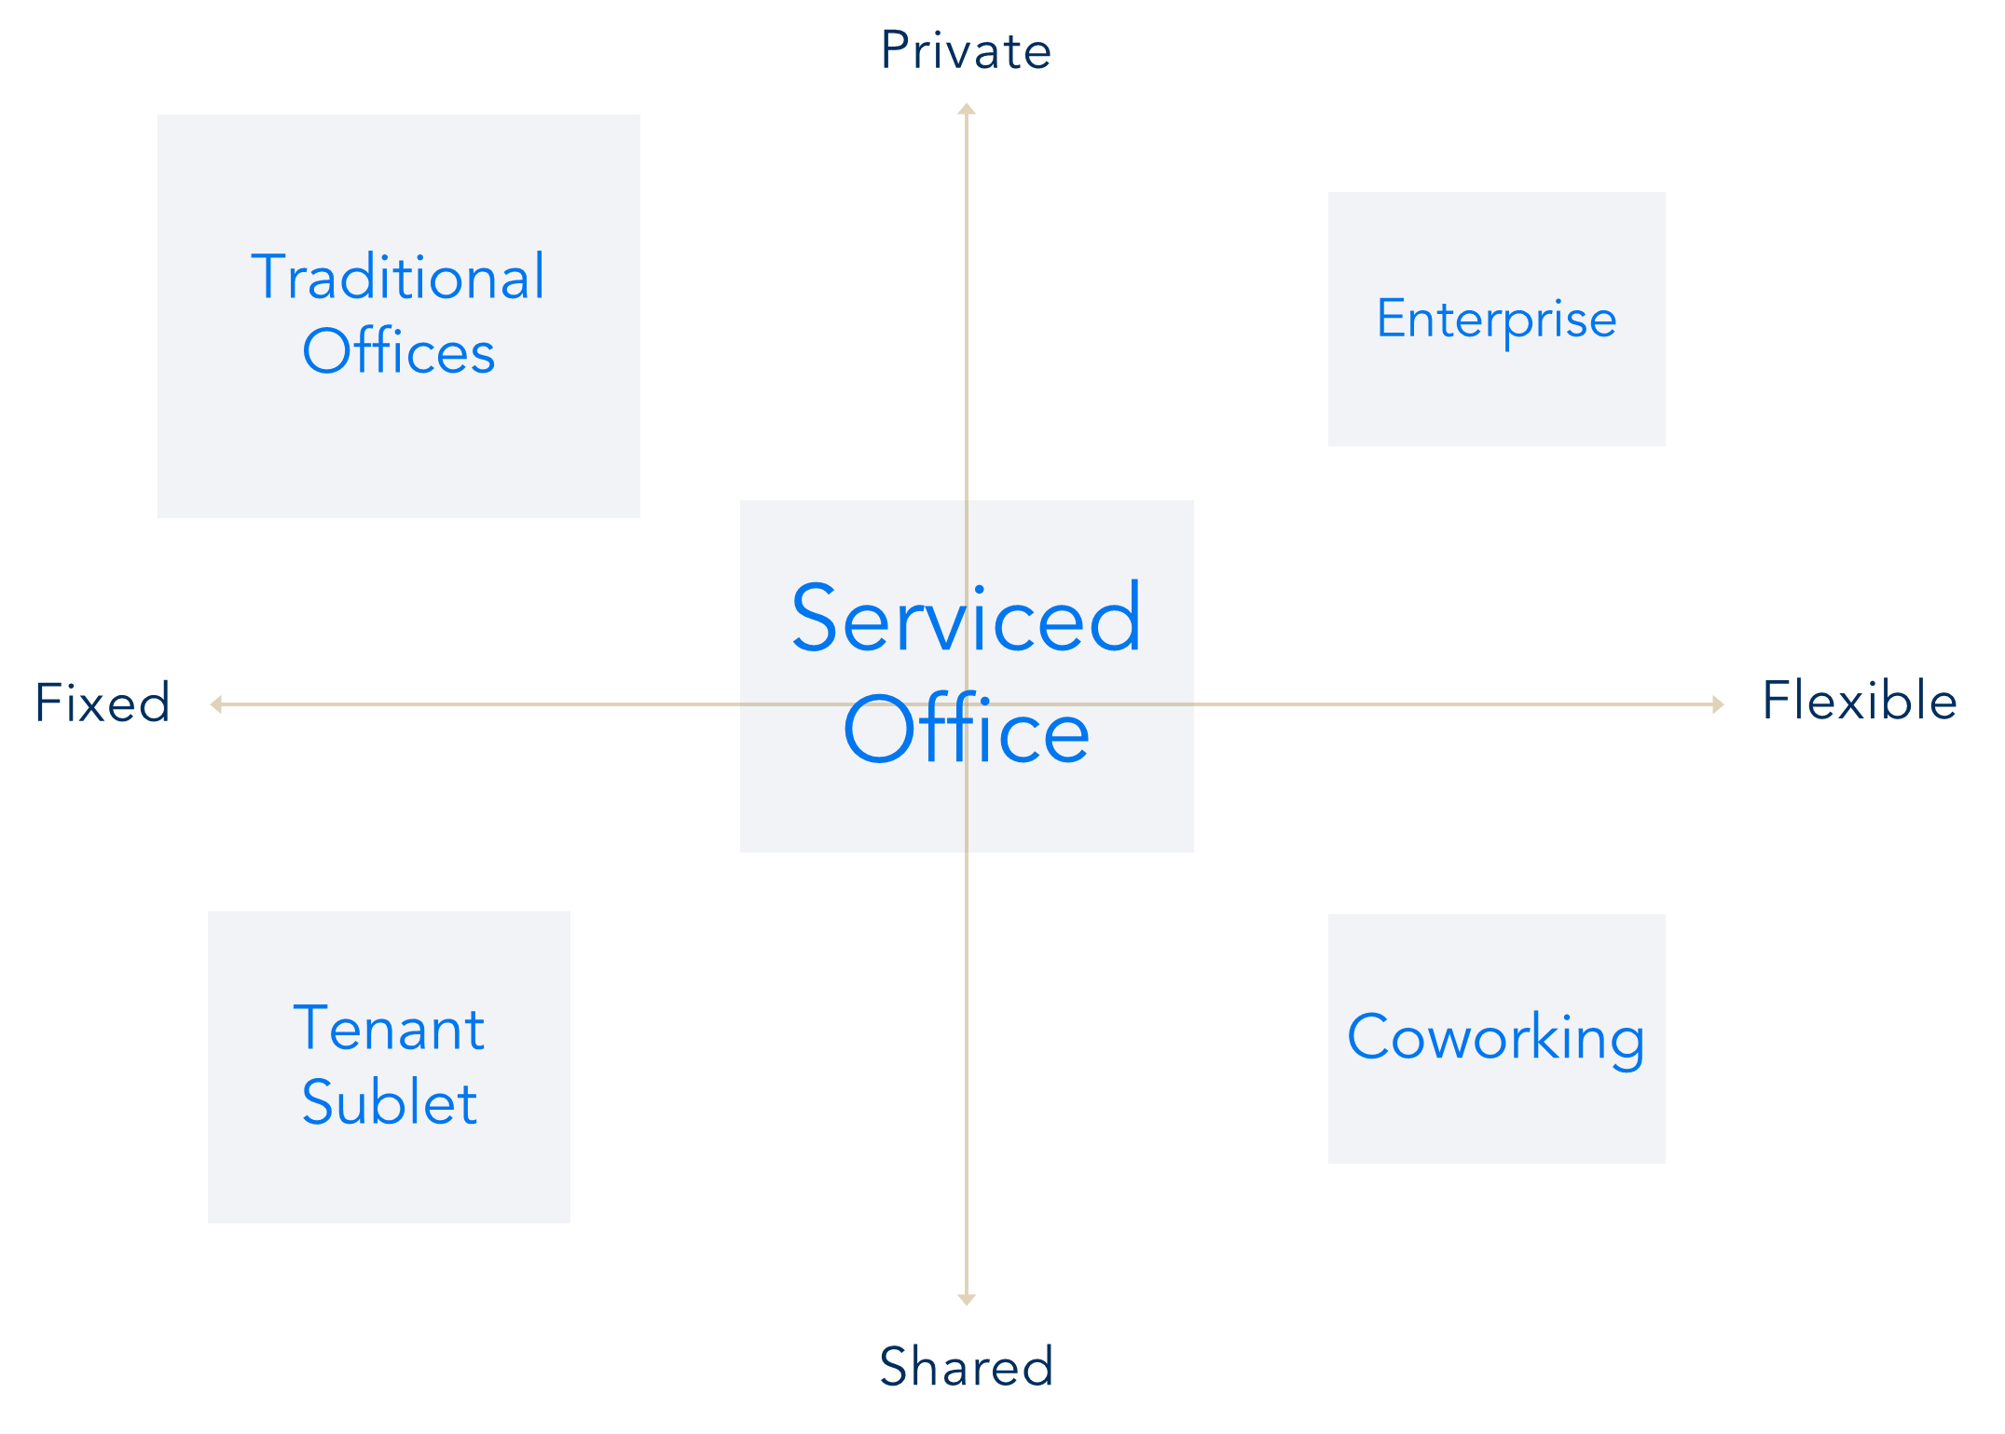









The Flexible Workspace Spectrum

Slide 27
Comparison: Know Your Market

Slide 28

Since: 1989
From: Belgium
Countries: 120+
Cities: 900+
Centres: 3,000+
Audience: Ambitious Professional / Young Entrepreneur
Fit-out Style: Average
Branding: Everywhere
Pricing: Rigid
Buildings: Grade A-B

Slide 29
Professional team Support: Limited
IT Infrastructure: Average
IT Support: Outsourced
Corporate Partnership: Very strong
Overall Strength of the Brand: Size

Slide 30

Since: 1978
From: Australia
Countries: 20+
Cities: 50+
Centres: 150+
Audience: Ambitious Professional
Fit-out Style: Premium, yet Classic Design
Branding: No Branding
Pricing: Rigid
Buildings: Grade A+

Slide 31
Professional team support: Yes
IT Infrastructure: Very strong
IT Support: In-house
Corporate Partnership: Limited
Overall Brand Strength: Premium Service and IT

Slide 32

Since: 2010
From: USA
Countries: 36+
Cities: 119+
Centres: 800+
Audience: Young Entrepreneur
Fit-out Style: Contemporary
Branding: Everywhere
Pricing: Flexible
Buildings: Grade A-B

Slide 33
Professional team Support: Limited
IT Infrastructure: Average
IT Support: Little
Corporate Partnership: Strong
Overall Strength: Brand and Design

Slide 34
Since: 1994
From: Hong Kong
Countries: 14
Cities: 32
Centres: 150+
Audience: Ambitious Professional
Fit-out Style: Premium, yet Contemporary
Branding: No Branding
Pricing: Very Flexible
Buildings: Grade A+

Slide 35
Professional Team Support: Yes
IT Infrastructure: Strong
IT Support: In-house
Corporate Partnership: Strong
Overall Strength: Premium Service and Design

Slide 36
Multiple-choice question
Where does TEC fall on the Serviced Office Spectrum?
A: Fixed and private
B: Private, flexible and shared
C: Flexible, shared and fixed
D: Flexible and shared

Slide 37
Multiple-choice question
Fill in the gap:
______ was founded in 1989 in Belgium and has 3000+ Centres across 120+ countries
A: Servcorp
B: WeWork
C: Regus
D: The Executive Centre

Slide 38
Multiple-choice question
Fill in the gap:
______ was founded in 2010 in USA and has 800+ Centres across 36+ countries
A: Servcorp
B: WeWork
C: Regus
D: The Executive Centre

